Slide 1
Face Recognition Attendance System
By:
L Sai Pranav Reddy 21BCE1762
Chikkam Venkat Satya Dhiraj 21BCE5717

Slide 2

Abstract
The new Facial Recognition Attendance System (FRAS) simplifies attendance tracking in schools, businesses, and organizations. Using LBPH (Local Binary Pattern Histogram),FRAS automatically identifies individuals, eliminating manual attendance taking. It ensures accuracy with advanced algorithms analyzing facial features. FRAS boosts efficiency, reduces administrative burden, and reduces attendance malpractice. It generates real-time attendance reports, aiding quick decision-making. The system's architecture, technical components, and diverse industry applications are outlined, with attention to privacy and ethical considerations for responsible deployment.

Slide 3
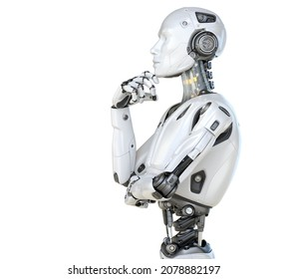
Introduction
Introducing the Face Recognition Attendance System (FRAS): a revolutionary solution for effortless attendance management. By leveraging facial recognition technology, FRAS automates the identification process, eliminating manual data entry. With advanced algorithms, it ensures accuracy and reliability in tracking attendance. FRAS streamlines operations, reduces administrative overhead, and reduces attendance malpractice. Its real-time reporting capabilities facilitate prompt decision-making. This introduction highlights FRAS's potential to transform attendance tracking in the field of education.

Slide 4
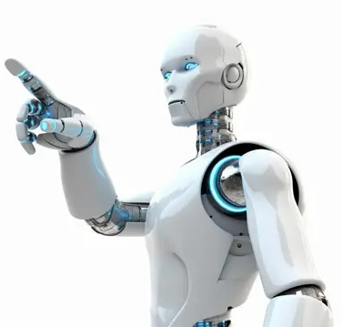
Objective
The Face Recognition Attendance System aims to revolutionize traditional attendance tracking methods by leveraging facial recognition technology to automate the identification process. Its primary goal is to streamline attendance management, reduce manual data entry, ensure accuracy and reliability in attendance tracking, minimize administrative overhead, enhance security, and provide real-time reporting capabilities for prompt decision-making.

Slide 5

Problem Statement
Develop a face recognition attendance system that accurately identifies individuals and records their attendance automatically, providing a seamless and efficient alternative to traditional methods.

Slide 6
Literature Review
TITLE | AUTHORS | FINDINGS/FUTURE WORK
1. Smart Attendance System based on improved Facial Recognition -2023 https://journal.umy.ac.id/index.php/jrc/article/view/16808 | Thai-Viet Dang | The study introduces a streamlined deep learning technique for facial recognition, employing an upgraded FaceNet model with MobileNetV2 backbone and SSD subsection. Utilizing depth-wise separable convolution, it achieves high accuracy and processing speed, ideal for practical use on low-capacity hardware, paving the way for smart automated attendance systems.
2. Face Recognition based Attendance System using Haar Cascade and Local Binary Pattern Histogram Algorithm https://ieeexplore.ieee.org/abstract/document/9143046 | Bharath Tej Chinimilli; Anjali T.; Akhil Kotturi; Vihas Reddy Kaipu; Jathin Varma Mandapati | This paper addresses the use of various attendance systems, highlighting the superiority of face recognition. It focuses on reducing false positives in face recognition attendance systems through thresholding, achieving a 77% student recognition rate with a 28% false positive rate, while also robustly recognizing individuals with glasses or facial hair, with a 60% recognition rate for unknown persons.
3. Design of Attendance System Based on Face Recognition and Android Platform https://ieeexplore.ieee.org/abstract/document/9239722 | Xiaojun Bai; Feihu Jiang; Tianyi Shi; Yuang Wu | This paper presents a face recognition-based attendance solution to overcome manual attendance limitations, utilizing mobile platforms and facial recognition technology. It outlines three main modules: information input, sign-in, and record, detailing face detection principles, classifier construction, and Android platform implementation, confirming feasibility through accuracy experiments.

Slide 7
TITLE | AUTHORS | FINDINGS/FUTURE WORK
4. Automatic Attendance System Using Face Recognition Technique https://d1wqtxts1xzle7.cloudfront.net/87419263/A2644059120-libre.pdf?1655095435=&response-content-disposition=inline%3B+filename%3DAutomatic_Attendance_System_Using_Face_R.pdf&Expires=1713379081&Signature=DM4hbZtnjSnyMSTR6UsM20P6AETTeYAULsBCVdMb8qc3Q~4CFLB9oZqZJGuCMa78ZHDgSJuSmCDnc6u5usQPymZeU6ZR5J-k4XOQ27JRejVHPlDAE0OQ9oCrfp-yiEPmwoPicJq7C2gZfRAkxrPJKeqeU8h~y2dy045El4dUD-57NSxXLWWRDXicRkHlXwYEo~KCPPhwSCnUgijkN6w8JqnHnyvZDXiNFeXTyLCLULtNuov2H-PAXKrq9qZNKP-5H0sp8f6Vbt63APh8YB7WJXD176QmPdCbbIJwsWjyB~juefshcB29U6oS21PMJ~cUFBVJxwaOohXYV9Bgt6wG9w__&Key-Pair-Id=APKAJLOHF5GGSLRBV4ZA | Mayur Surve, Priya Joshi, Sujata Jamadar, Minakshi Vharkate | This paper emphasizes the significance of attendance systems in educational institutions and highlights the challenges of manual methods. By leveraging face recognition technology, it aims to enhance accuracy and efficiency, particularly focusing on implementing a system using the Haar Cascade Algorithm, known for its superior accuracy. This system features a user-friendly interface for image capture, dataset creation, and training, enabling automatic attendance recording with student identification and timestamp.
5. Face Recognition Attendance System Based on Real-Time Video Processing https://ieeexplore.ieee.org/abstract/document/9138372 | Hao Yang; Xiaofeng Han | This paper investigates the creation of a real-time video-based attendance system employing face recognition technology, influenced by the era of big data and rising commercial interest. It tackles accuracy, stability, truancy reduction, and interface design, providing a fresh solution that improves efficiency and diminishes truancy within educational settings.
6. Student Attendance System using Face Recognition https://ieeexplore.ieee.org/abstract/document/9215441 | Samridhi Dev; Tushar Patnaik | This paper introduces an innovative attendance system utilizing cutting-edge face recognition technologies to modernize traditional attendance procedures. Through rigorous testing, it showcases its effectiveness in streamlining attendance processes, ensuring accuracy, and minimizing manual efforts.

Slide 8
TITLE | AUTHOR | FINDINGS /FUTURE WORK
7. Real Time Automatic Attendance System for Face Recognition Using Face API and OpenCV https://link.springer.com/article/10.1007/s11277-020-07224-2 | Sikandar Khan, Adeel Akram & Nighat Usman | This paper addresses the inefficiencies of manual attendance tracking by proposing a modern solution utilizing smartphones for faculty members. Leveraging advanced object detection algorithms like YOLO V3 and Microsoft Azure's face API ensures accurate and efficient attendance monitoring, with automatic email notifications for students, parents, and faculty members at the end of each month.
8. Face Recognition Based Smart Attendance System https://ieeexplore.ieee.org/abstract/document/9160184 | A Arjun Raj; Mahammed Shoheb; K Arvind; K S Chethan | This paper introduces a computerized attendance system leveraging facial recognition technology to address attendance inconsistencies in educational institutions. Utilizing Raspberry Pi, OpenCV, and Dlib, the system ensures accurate attendance tracking, notifies parents of absences via GSM, and provides students with a user-friendly Android application for monitoring their attendance.
9. Face Recognition Smart Attendance System using Deep Transfer Learning https://www.sciencedirect.com/science/article/pii/S1877050921019232 | Khawla Alhanaee ª, Mitha Alhammadi ª, Nahla Almenhali ª, Maad Shatnawi ª | This paper presents a facial recognition attendance system using deep learning CNNs, leveraging transfer learning for efficient training and achieving high prediction accuracy. It addresses the complexity of attendance management systems by providing a robust solution based on widely-used biometric authentication techniques.

Slide 9

Proposed Methodology
Face recognition Attendance System using
OpenCV, LBPH(Local Binary Pattern Histogram)
and flask framework.

Slide 10
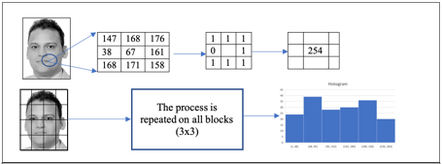
LBPH
LBPH (Local Binary Patterns Histograms) is a texture descriptor used in computer vision and image processing. It's particularly effective for texture classification and facial recognition tasks. LBPH works by dividing an image into small regions, then computing a binary pattern based on the intensity values of the pixels within each region. These patterns are then used to construct histograms, which capture the distribution of different texture patterns in the image. This approach allows LBPH to encode local texture information effectively, making it robust to changes in lighting conditions and facial expressions.

Slide 11
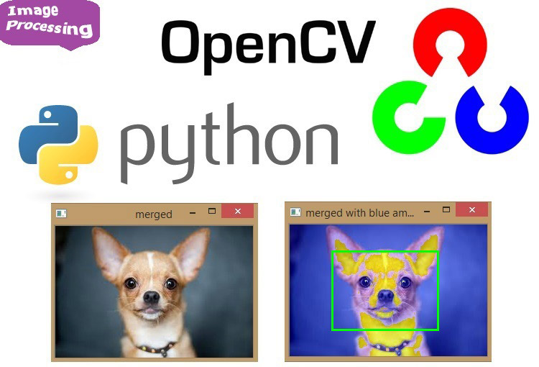
Open Cv
OpenCV (Open Source Computer Vision Library) is a versatile open-source toolkit for computer vision and machine learning tasks. Designed to facilitate real-time processing and image analysis, OpenCV offers a wide range of algorithms and tools for tasks like object detection, image segmentation, face recognition, and more. With support for multiple programming languages like Python and C++, it has become a popular choice among developers and researchers. Its extensive collection of functions and ease of integration with other frameworks make it ideal for creating applications in robotics, artificial intelligence, surveillance, and augmented reality.

Slide 12
Flow of Project
Inputs:
Name
ID no
Class no
Picture of the person
So here we take inputs from the user for their identification of their face ,Reg no,Class no and Name.

Slide 13
Registration:
Pictures of Register Members
Registered members excel sheet
Here after filling details the data is splited into two one is storing face images which will going to face folders and other is saved details of members in excel sheet

Slide 14
Training:
Taking face images from Face folder
Training of images using LBPH algo
Face_trained.yml

Slide 15
Taking attendance
Face_trained.yml
Attendance
Image of student while taking attendance
Attendance.excel

Slide 16
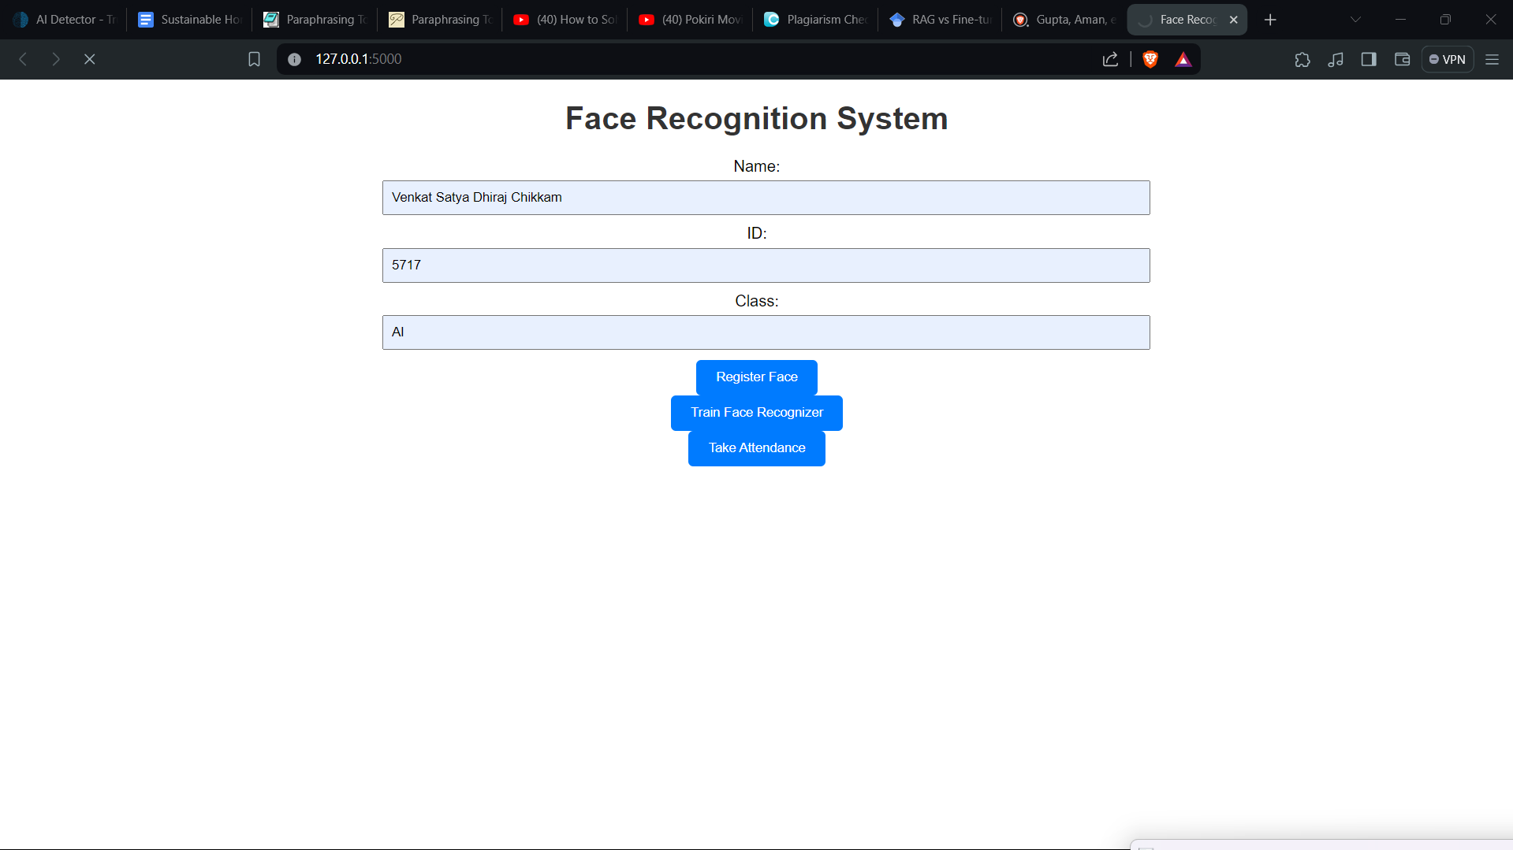
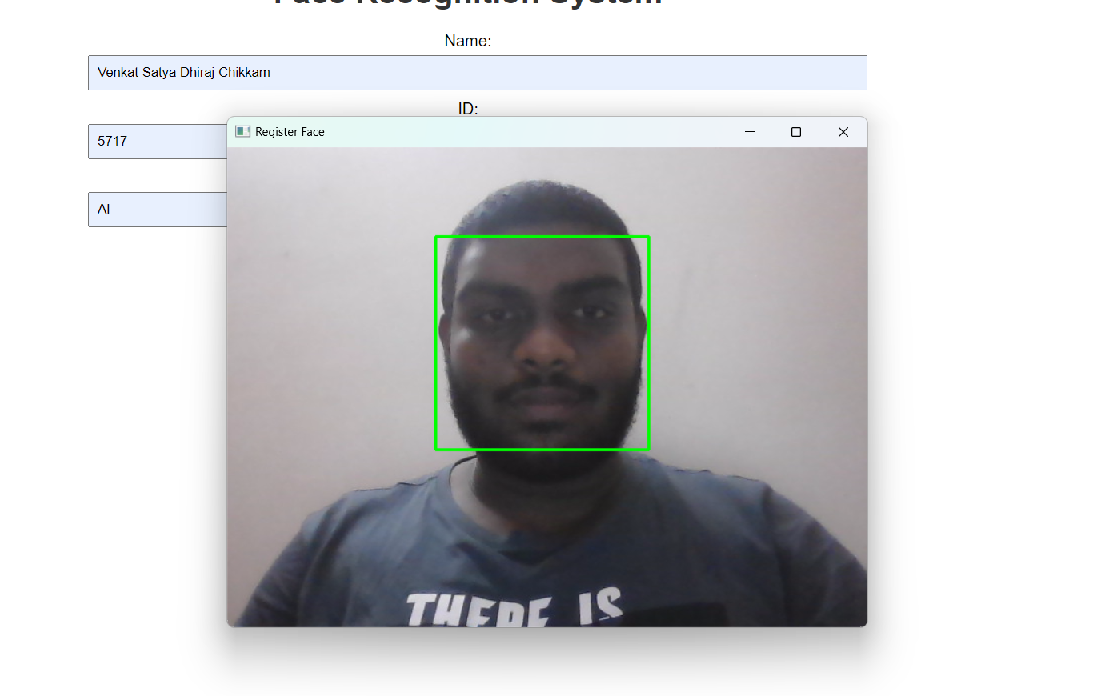
Outputs:

Slide 17
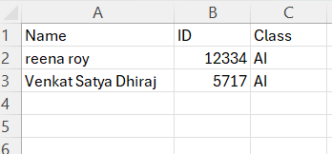
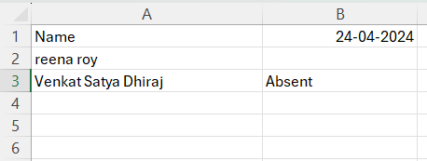
Registration Excel Attendance Excel

Slide 18
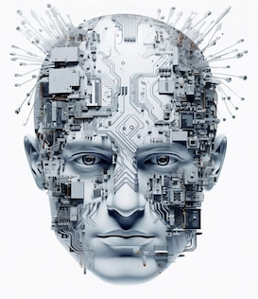
conclusion
The project of developing a face detection attendance system using the Local Binary Pattern Histogram (LBPH) method demonstrates a practical and efficient approach to automating attendance tracking. By leveraging LBPH's robustness to variations in lighting and facial expressions, the system ensures reliable face recognition, enabling accurate identification of individuals in diverse settings. This technology-driven approach minimizes manual errors, enhances security, and streamlines attendance management processes. The project's success highlights the potential for integrating computer vision techniques in real-world applications, offering a scalable and adaptable solution for educational institutions, workplaces, and other organizational environments.

Slide 19
Thank You

